Slide 1
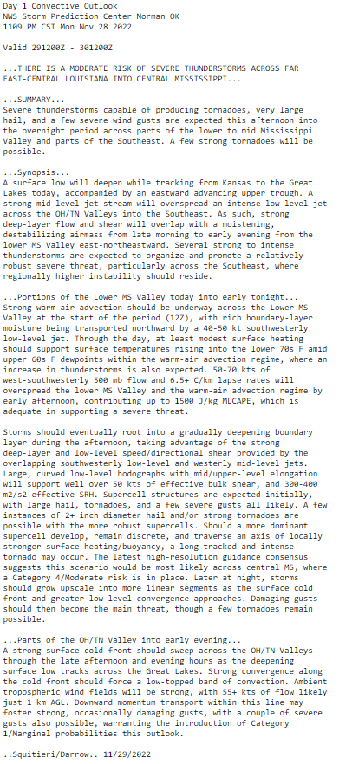
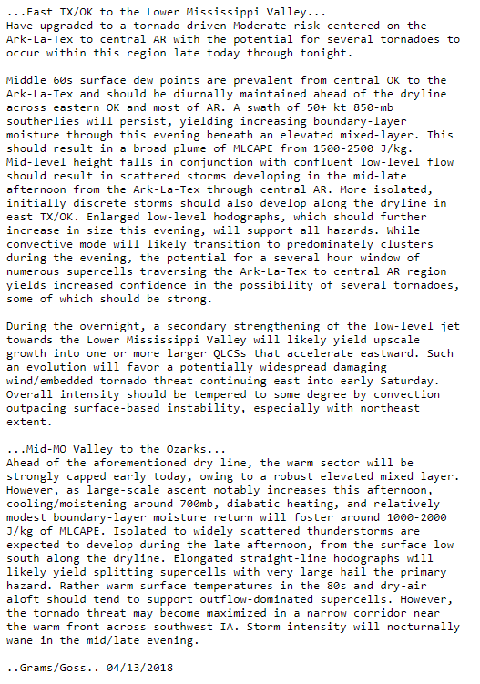
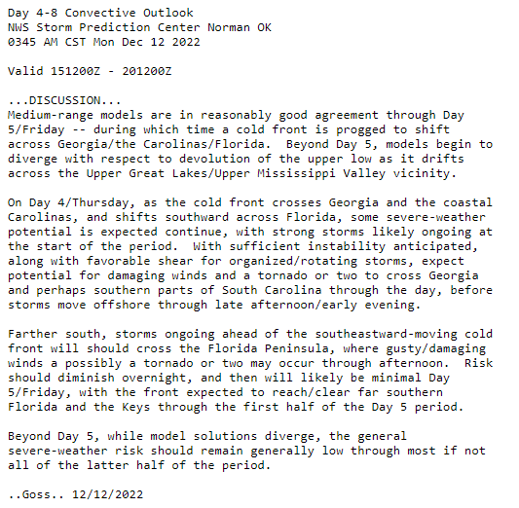
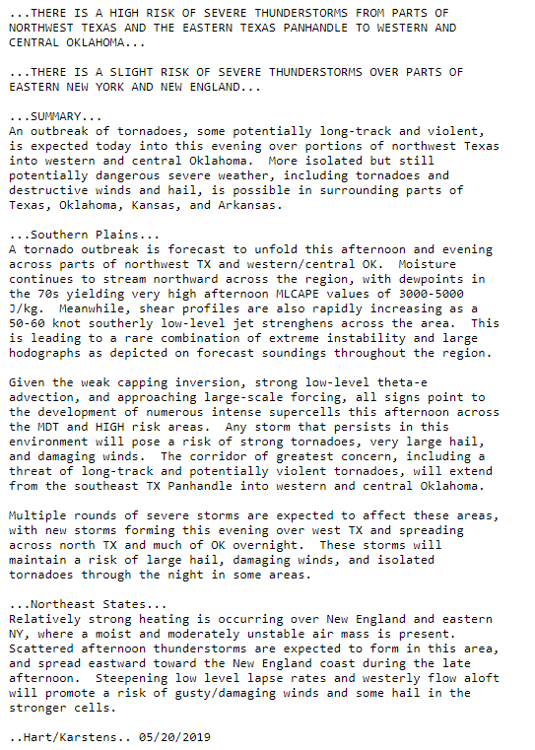
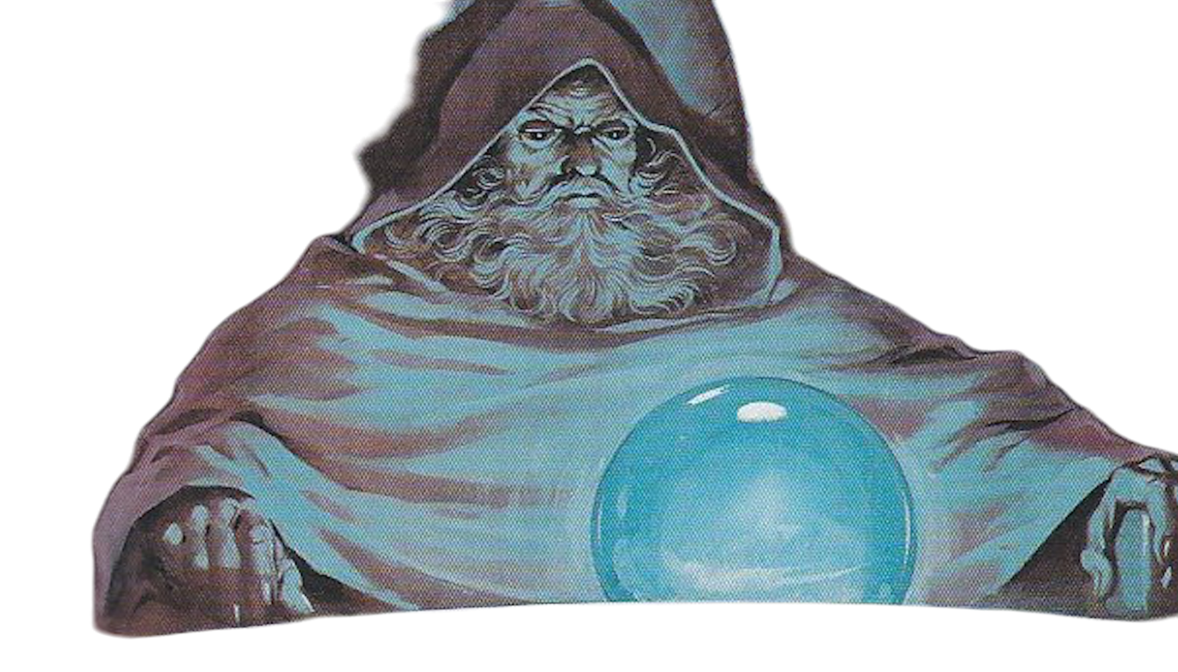
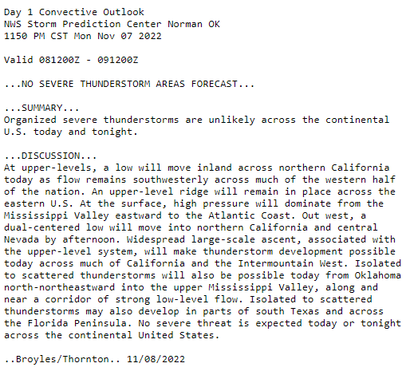

Probabilistic
Thinking &
Forecast
Communication

Slide 2

Probabilistic Forecasting
How do we think probabilistically?
Consider the Following:
Can you predict the outcome of when you roll a die?

Slide 3
Probabilistic Forecasting
How do we think probabilistically?
Consider the Following:
Can you predict the outcome of when you roll a die?
Theoretically: Yes - *if* you know all of the initial conditions precisely
(nearly impossible)
In practice: No, we can only describe the outcome in terms of probabilities.

Slide 4

Probabilistic Forecasting
How do we think probabilistically?
Key insight: We must be able to describe the range of all potential outcomes for a given forecast space.
So for a 20 sided die:
50% chance of landing on an even number
30% chance of landing on a number divisible by 3
5% chance of landing on any particular number

Slide 5
Probabilistic Forecasting
How do we think probabilistically?
How can we determine the range of possible outcomes for the weather?
Example: It’s late February, how do you know it won’t be 100 F tomorrow?

Slide 6
Probabilistic Forecasting
How do we think probabilistically?
How can we determine the range of possible outcomes for the weather?
Example: It’s late February, how do you know it won’t be 100 F tomorrow?
Climatology - How many times has 100 F occurred in the past?

Slide 7
Probabilistic Forecasting
How do we think probabilistically?
How can we determine the range of possible outcomes for the weather?
Example: It’s late February, how do you know it won’t be 100 F tomorrow?
Climatology - How many times has 100 F occurred in the past?
Multiple Model Runs - How many deterministic models show 100 F?

Slide 8
Probabilistic Forecasting
How do we think probabilistically?
How can we determine the range of possible outcomes for the weather?
Example: It’s late February, how do you know it won’t be 100 F tomorrow?
Climatology - How many times has 100 F occurred in the past?
Multiple Model Runs - How many deterministic models show 100 F?
Ensembles - How many ensemble members show 100 F?

Slide 9
Probabilistic Forecasting
How do we think probabilistically?
How can we determine the range of possible outcomes for the weather?
Example: It’s late February, how do you know it won’t be 100 F tomorrow?
Climatology - How many times has 100 F occurred in the past?
Multiple Model Runs - How many deterministic models show 100 F?
Ensembles - How many ensemble members show 100 F?
All of these help us describe the forecast probability space.

Slide 10
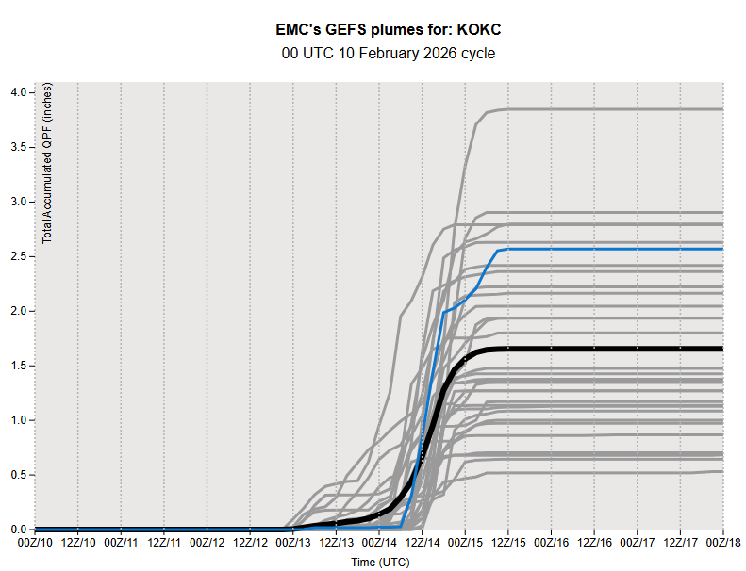
Probabilistic Forecasting
Note the distribution of
rainfall amounts.
How would you describe:
The potential for > 1” of rain?
The potential for > 3” of rain?
The most likely rainfall amounts?
These questions can’t be answered with a single deterministic model!

Slide 11
Deterministic vs. Probabilistic Forecasting
Deterministic: “Latest GFS shows OKC receives 2.5 inches of rainfall later this week.”
Probabilistic: “Most ensemble members show rainfall amounts between 1 to 1.5 inches, though higher amounts appear possible.”

Slide 12
Deterministic vs. Probabilistic Forecasting
Probabilistic: “Most ensemble members hint at rainfall amounts between 1 to 1.5 inches, though higher amounts appear possible.”
Why is this a better option?
Gives most likely outcome.
Acknowledges the potential for a high-end event.
And…

Slide 13
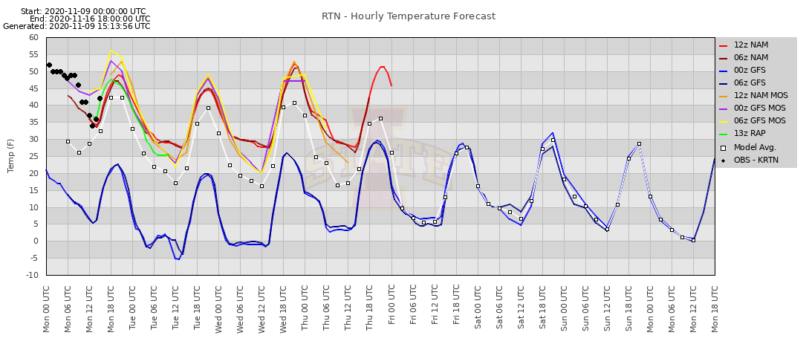
Deterministic vs. Probabilistic Forecasting
Probabilistic: “Most ensemble members hint at rainfall amounts between 1 to 1.5 inches, though higher amounts appear possible.”
Why is this a better option?
Allows for the possibility that the GFS is simply wrong!

Slide 14
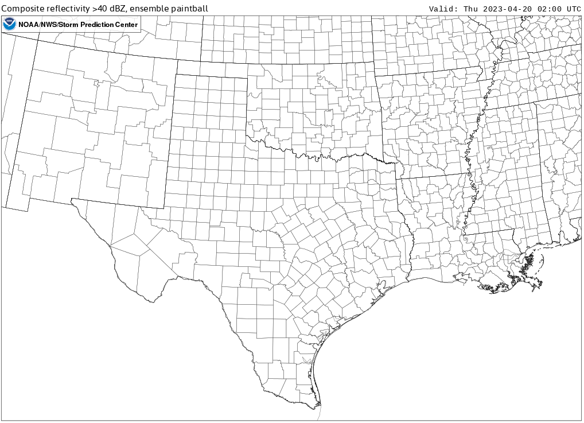
Deterministic vs. Probabilistic Forecasting
HRRR
Deterministic: “Latest HRRR says that no thunderstorms will occur this evening.”

Slide 15
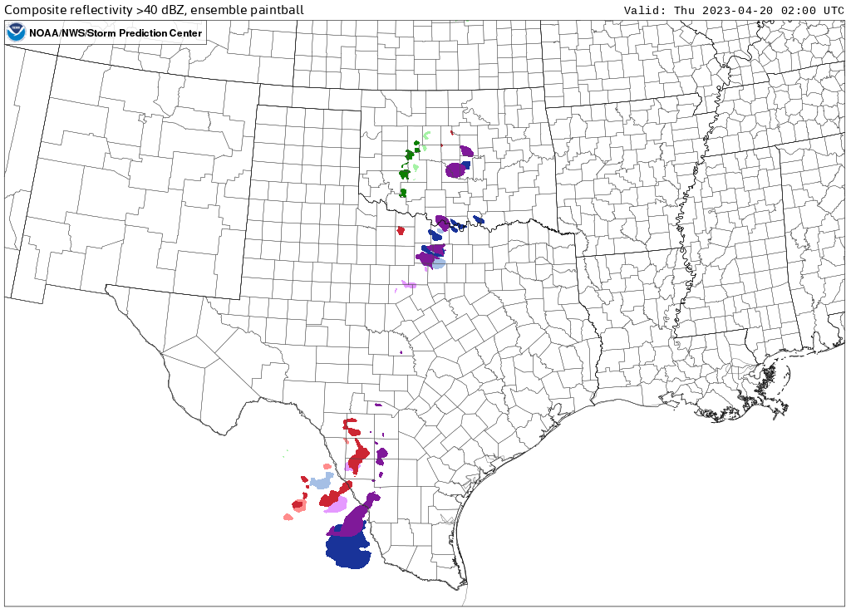
Deterministic vs. Probabilistic Forecasting
HREF All Members
Deterministic: “Latest HRRR says that no thunderstorms will occur this evening.”
Probabilistic: “HREF members suggests that isolated thunderstorms are possible this evening.”

Slide 16
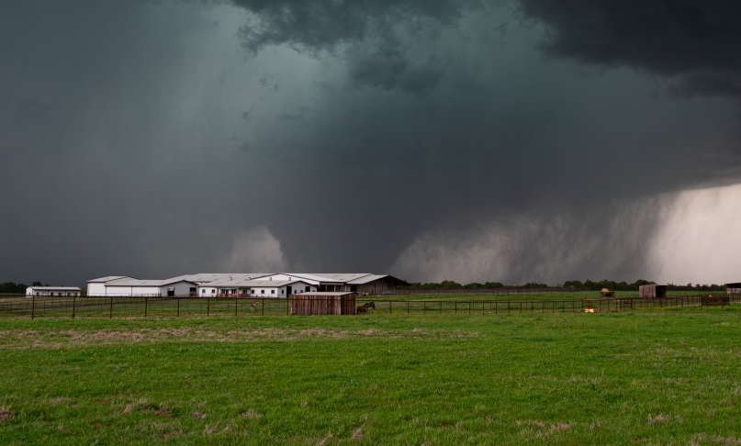
Deterministic vs. Probabilistic Forecasting
HREF All Members
Deterministic: “Latest HRRR says that no thunderstorms will occur this evening.”
Probabilistic: “HREF members suggests that isolated thunderstorms are possible this evening.”
HRRR forecast = More precise but wrong
HREF forecast = Less precise but conveys potential for bad outcome!
Which should you convey?
EF-3 near Cole, OK
Courtesy of Sean Earnst

Slide 17
Probabilistic Forecasting
Multi-model Ensemble
Consists of different dynamic model cores
(e.g. HREF, REFS)
Different cores have different biases, results in better dispersion and a more accurate forecast.
Can still hold value even if one model initializes poorly.
Single-model Ensemble
Consists of same dynamic core but with different physics engines and perturbed initial conditions.
(e.g. GEFS, ECENS)
Same model core means same model bias. Underdispersion can lead to false high confidence.
Have a much higher number of members that often better resolve the probability distribution.

Slide 18
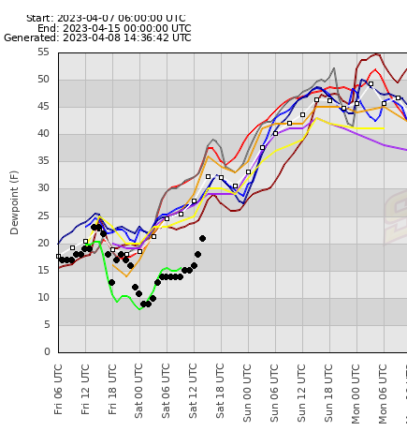
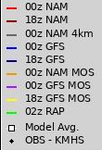
Probabilistic Forecasting
Multi-model Ensemble
Several models did not capture the observed trends, but…
There was enough spread among the different models to capture the bulk of the observations.
Always check out models are initializing compared to observations, reduce weight for the members that have initialized poorly.
Which model should you trust the most in this case?

Slide 19
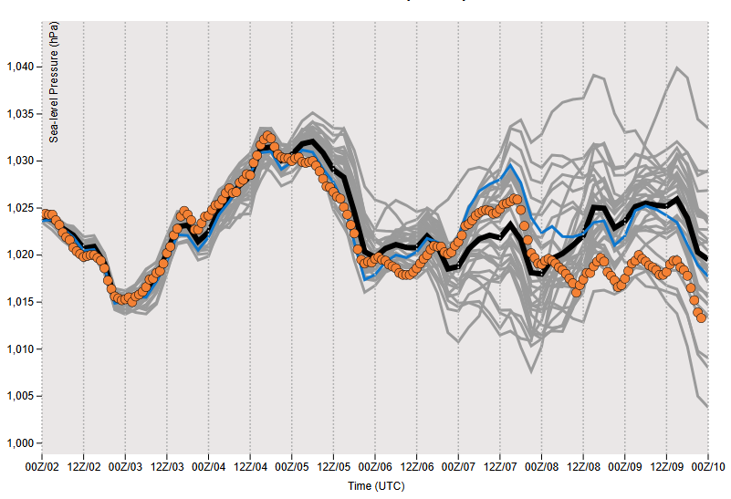
Probabilistic Forecasting
Single-model Ensemble
Notice the spread towards the end of the forecast period.
The deterministic GFS and ensemble mean were off the mark, but…
There was enough ensemble members and enough dispersion to capture the correct outcome!
GEFS Mean Sea Level Pressure Forecast
Higher Confidence
Lower Confidence

Slide 20
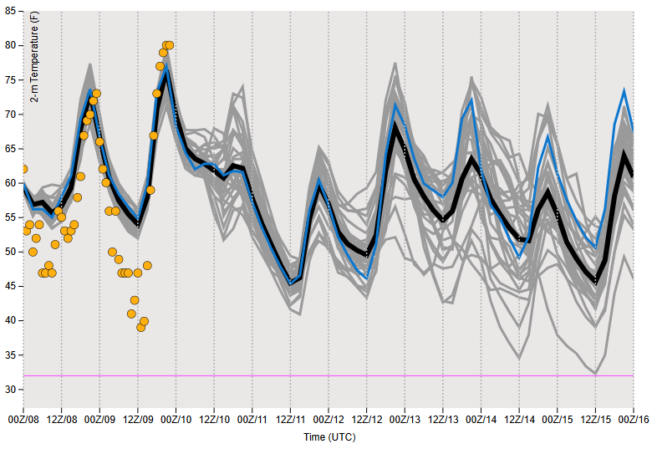
Probabilistic Forecasting
Single-model Ensemble
Notice the tight ensemble clustering.
This implies high forecast confidence, but…
Model biases did not capture nocturnal cooling trends well
Result = poor forecast due to the same model bias in all members!
GEFS 2-m Temperature Forecast

Slide 21
Probabilistic Communication
Should you mention the potential for catastrophic flooding?
Catastrophic Flash Flooding Threshold

Slide 22


Probabilistic Communication
Should you mention the potential for catastrophic flooding?
Who are you talking to?
Catastrophic Flash Flooding Threshold
Probably not
Yes!
Notes:
Note: GEFS has 31 members, so a 1/31 (or 3%) chance of flooding.

Slide 23
Probabilistic Communication
How would you characterize the potential for catastrophic flooding?
Very low
Minimum
Virtual none
Highly unlikely
Catastrophic Flash Flooding Threshold

Slide 24
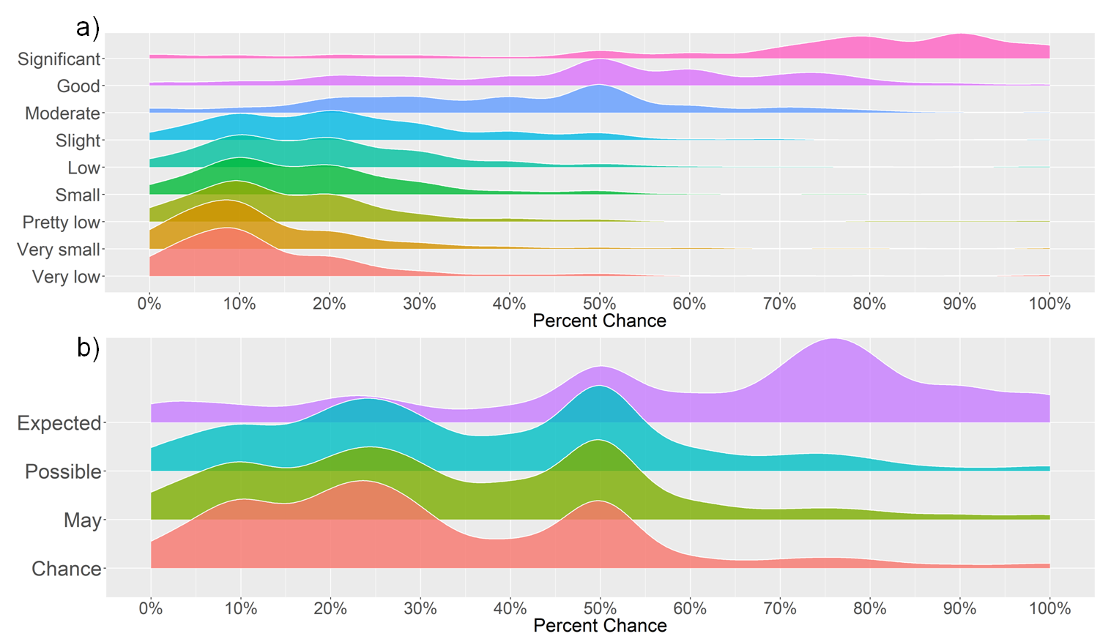
Probabilistic Communication
“... a combination of words and numbers may be ideal for increasing understanding of probability.” - Lenhardt et al. 2020
People associate numeric values to certain words.
However, interpretation can vary widely for different words!
Example: “Expected”
can be interpreted to mean
45% to 80%
based on surveys
Fig. 5 from Lenhardt et al. 2020

Slide 25


Probabilistic Communication
How would you characterize the potential for catastrophic flooding?
Very low
Minimum
Virtual none
Highly unlikely
Very Low (3%) Chance
Catastrophic Flash Flooding Threshold

Slide 26
Probabilistic Forecasting
Quick Recap
Probabilistic forecast allows you to assess the likelihood of an outcome or range of outcomes.
Climatology and ensembles help you quantify the range of outcomes.
A combination of words and numbers can help you clearly convey potential outcomes.
Be aware of ensemble limitations and biases.

Slide 27
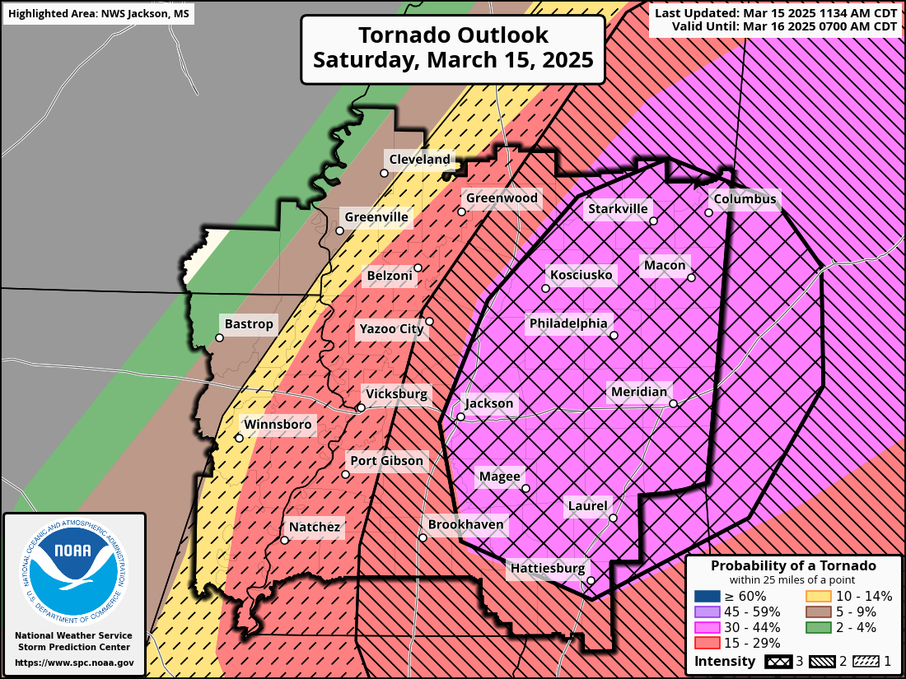
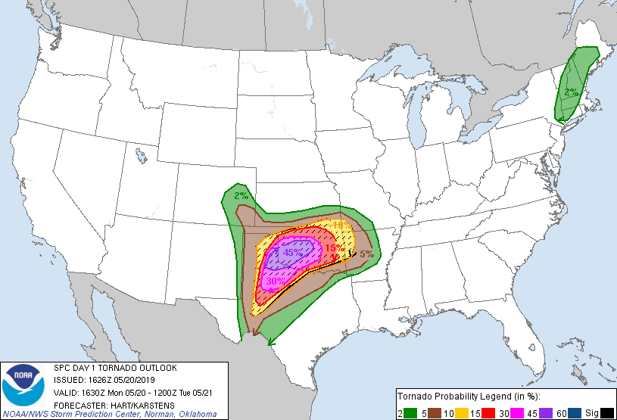

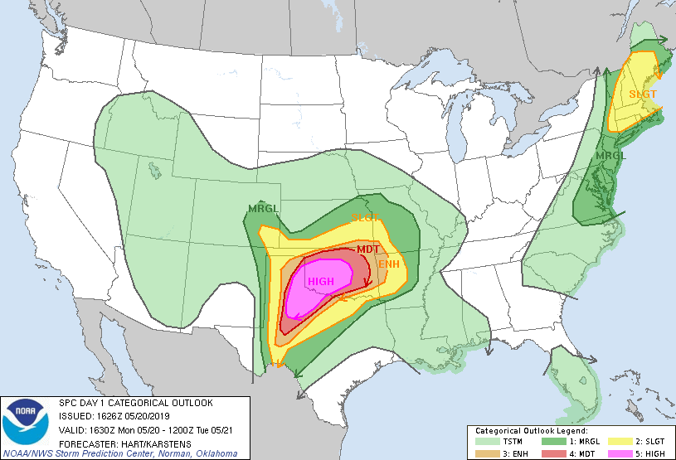
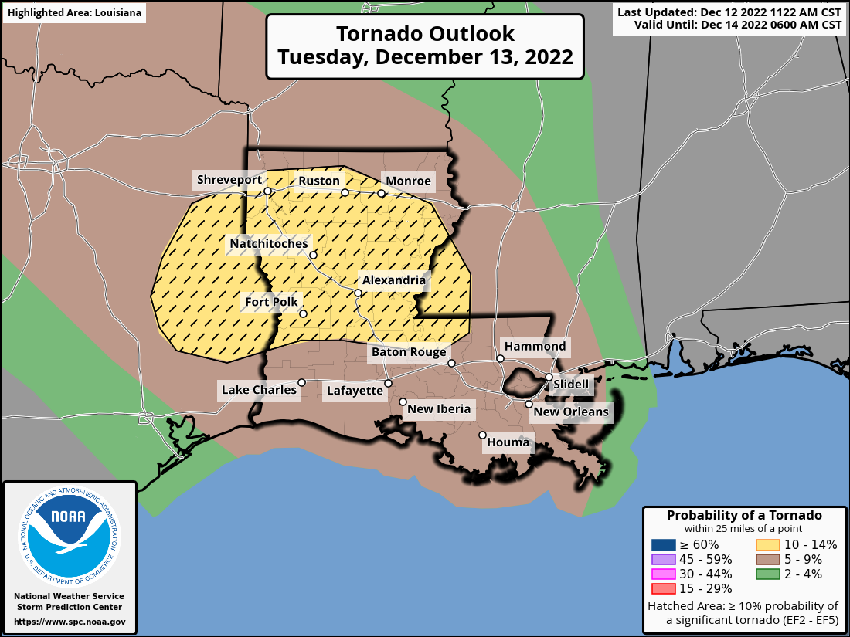
There are so many graphics
these days…
Why do we still bother with forecast discussions?

Slide 28
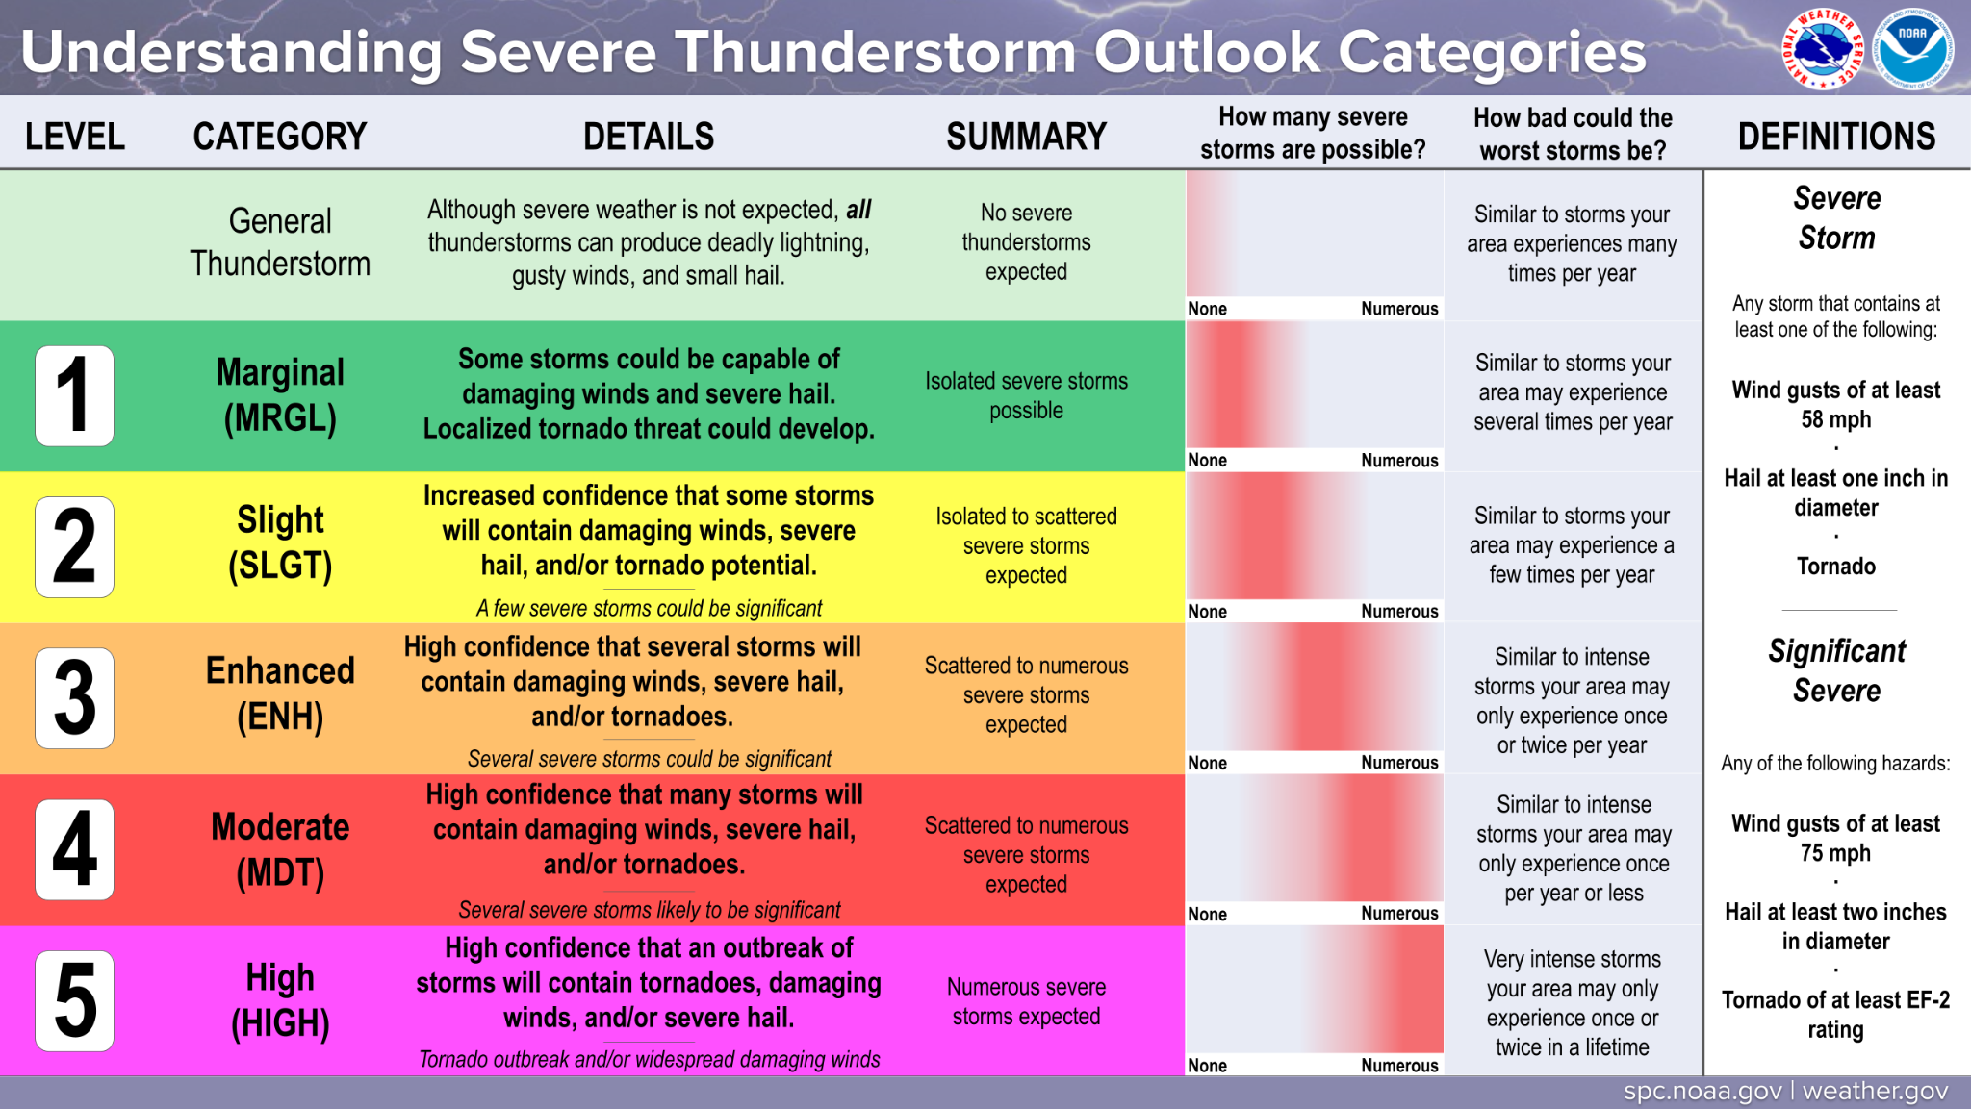
Graphics are great, but they can’t convey all of the forecast information
All of this text is needed to just explain the SPC Convective Outlook Graphic.
We can’t expect the public to know these details or the nuance of each forecast.
This nuance is best conveyed via the forecast discussion.

Slide 29
Anatomy of a Forecast Discussion
Summaries the main/most important point of the discussion. Ask yourself “If people take one thing away from my discussion, what is it?”
Example: “Strong to severe thunderstorms are possible after 3 PM today for central Oklahoma.”
Summary/Bottom Line Up Front
Discusses main synoptic features and how they should evolve over the forecast period. Example: “The surface low is forecast to deepen as it moves east into AR.”
Synopsis/Feature Identification
Goes into more regional-focused detail regarding the severe weather potential. Discusses how the convective environment should evolve, convective modes, trends, main hazards, etc...
Detailed Forecast Information
Conveys confidence in the forecast outlined above. Should include the most likely scenario as well as best/worst case potential outcomes and conditional risks.
Example: “A severe storm or two is possible if convection can initiate along the dryline before sunset.”
Confidence Communication

Slide 30
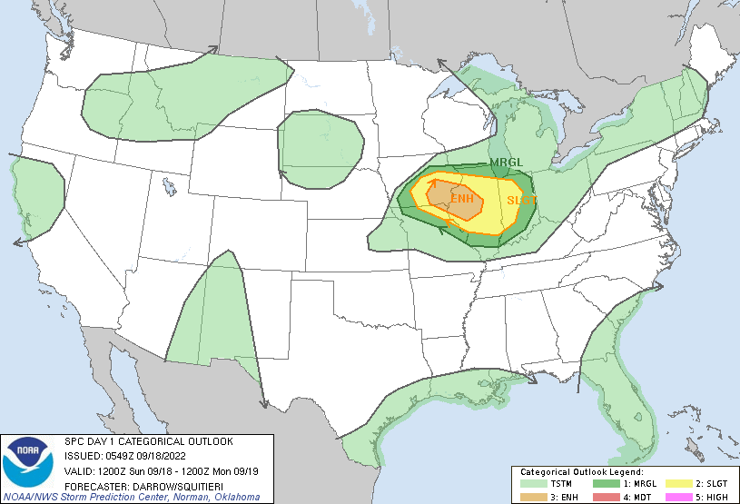
Anatomy of a Forecast Discussion
...THERE IS AN ENHANCED RISK OF SEVERE THUNDERSTORMS ACROSS PARTS OF
THE MID MISSISSIPPI VALLEY...
...SUMMARY...
Scattered severe thunderstorms should develop across the Mid
Mississippi Valley late Sunday afternoon. Hail, wind, and some
threat for a few tornadoes will spread toward central Illinois
during the evening hours.
...Mid Mississippi Valley...
Late-evening model guidance suggests upper ridge will build across
the southern Plains and strengthen during the day1 period. This
feature will force a notable short-wave trough currently located
over WY to top the ridge over eastern SD/NE around 18z before it
turns southeast and digs toward the OH Valley by 19/12z. As a
result, broad height rises will be noted across much of the
western/central US during the first half of the period.
Early this morning, thunderstorm clusters continue across southern
IA with more isolated activity into eastern KS. This activity is
likely being sustained by a focused LLJ that should move little over
the next 36hr, aside from veering toward central IL Sunday evening.
Remnants of this convection are expected to be ongoing at the
beginning of the period from southeast IA into central IL. Latest
guidance suggests weakening is likely after sunrise, though it may
not completely dissipate as it propagates southeast. While
marginally severe hail/wind could occur with this early-period
convection, the primary concern for more significant severe will
occur later in the afternoon/evening as influence of the
aforementioned short wave approaches.
Strong boundary-layer heating is forecast once again across KS where
surface temperatures may approach 100F in the central part of the
state. Readings into the low-mid 90s are possible across northwest
MO. If this occurs convective temperatures may be breached around
22z. There is some concern that isolated convection could develop
along the boundary shortly after peak heating but large-scale
forcing will not be particularly focused before sunset. However, as
the short wave digs southeast, scattered convection will likely
develop near the boundary over central IA. Forecast soundings favor
supercells, which should mature and dig east-southeast toward a very
unstable air mass with MUCAPE in excess of 4000 J/kg. Very steep
lapse rates and favorably forced/sheared environment suggest very
large hail with the stronger storms. Additionally, while these
updrafts may be slightly elevated, low-level shear appears favorable
for some risk of tornadoes. Latest HREF guidance supports this
scenario with a cluster of supercells evolving over IA and growing
upscale as they spread toward central IL during the late evening.
Damaging winds may also occur, especially if storm mergers and
bow-type features evolve.
Summaries the main/most important point of the discussion. Ask yourself “If people take one thing away from my discussion, what is it?”
Example: “Strong to severe thunderstorms are possible after 3 PM today for central Oklahoma.”
Example discussion from
06Z Day 1 Sept 18, 2022
Summary/Bottom Line Up Front
Discusses main synoptic features and how they should evolve over the forecast period. Example: “The surface low is forecast to deepen as it moves east into AR.”
Synopsis/Feature Identification
Goes into more regional-focused detail regarding the severe weather potential. Discusses how the convective environment should evolve, convective modes, trends, main hazards, etc...
Detailed Forecast Information
Conveys confidence in the forecast outlined above. Should include the most likely scenario as well as best/worst case potential outcomes and conditional risks.
Example: “A severe storm or two is possible if convection can initiate along the dryline before sunset.”
Confidence Communication
Notes:
Note: student’s don’t actually have to read the discussion. This is just to illustrate the point that SPC forecast discussions generally follow this outline. Students who are interested can go find this discussion from the 06 UTC outlook on Sept 18, 2022.

Slide 31

Content of a Forecast Discussion
Use words to paint a picture of the severe weather forecast!
Each point you make should serve the purpose of adding to the overall picture.

Slide 32
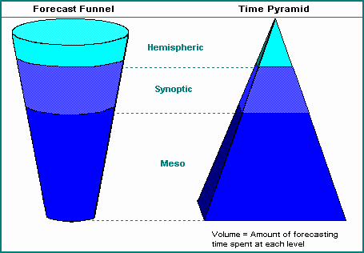
Content of a Forecast Discussion
Use the forecast funnel to structure your discussion.
Start at the synoptic scale
and work down!

Slide 33
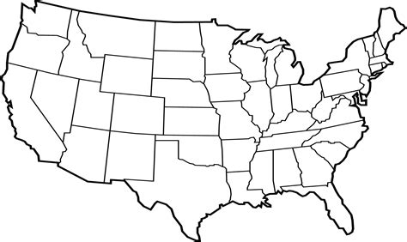
Content of a Forecast Discussion
A 500 mb trough will move east...
Use words to paint a picture of the severe weather forecast!
Each point you make should serve the purpose of adding to the overall picture.

Slide 34
Content of a Forecast Discussion
A 500 mb trough will move east...
Which will help deepen a low over NE...
Use words to paint a picture of the severe weather forecast!
Each point you make should serve the purpose of adding to the overall picture.
L

Slide 35
Content of a Forecast Discussion
A 500 mb trough will move east...
Which will help deepen a low over NE...
In response, southerly winds will increase and draw moisture northward into MO...
Use words to paint a picture of the severe weather forecast!
Each point you make should serve the purpose of adding to the overall picture.
L

Slide 36
Content of a Forecast Discussion
A 500 mb trough will move east...
Which will help deepen a low over NE...
In response, southerly winds will increase and draw moisture northward into MO...
The additional moisture and sunny conditions will
help increase CAPE by late afternoon...
Use words to paint a picture of the severe weather forecast!
Each point you make should serve the purpose of adding to the overall picture.
L

Slide 37

Content of a Forecast Discussion
A 500 mb trough will move east...
Which will help deepen a low over NE...
In response, southerly winds will increase and draw moisture northward into MO...
The additional moisture and sunny conditions will
help increase CAPE by late afternoon...
This will increase our thunderstorm chances by 4 PM.
Use words to paint a picture of the severe weather forecast!
Each point you make should serve the purpose of adding to the overall picture.
L

Slide 38
Content of a Forecast Discussion
A 500 mb trough will move east...
Which will help deepen a low over NE...
In response, southerly winds will increase and draw moisture northward into MO...
The additional moisture and sunny conditions will
help increase CAPE by late afternoon...
This will increase our thunderstorm chances by 4 PM.
Excellent Work!
Notice how nicely the discussion flows. Each line builds on the previous sentence and supports the next sentence, leading to main point!
L

Slide 39
Content of a Forecast Discussion
Keep in mind:
Use only as many words as necessary!
Calm weather = fewer words.
Impactful weather = more words.

Slide 40
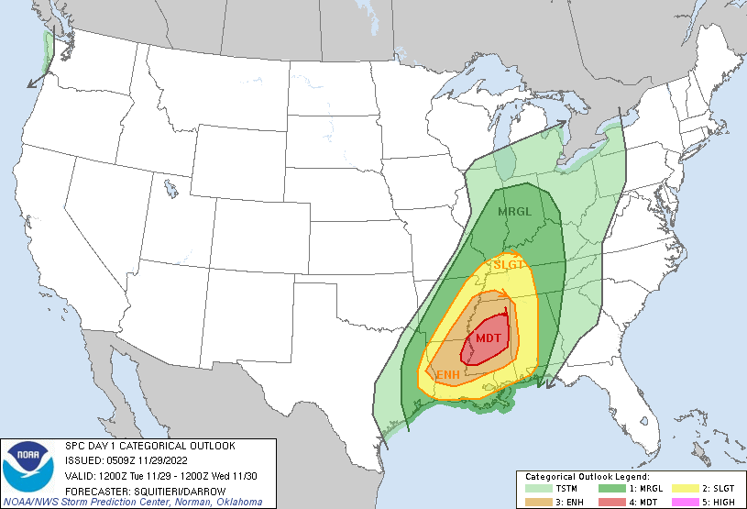
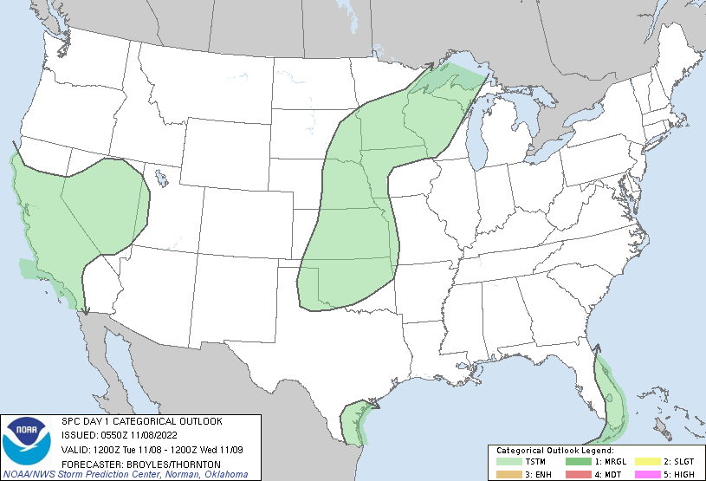
Content of a Forecast Discussion
High Impact
Low Impact

Slide 41
But wait!
This sounds deterministic!
Aren’t we supposed to use probabilities to convey the forecast?
We can still incorporate probabilistic language while describing the forecast evolution.
Try to convey confidence as you go.

Slide 42
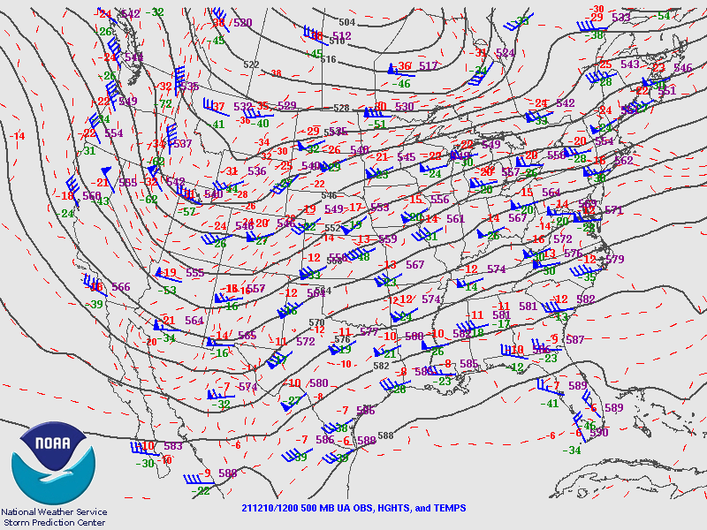
Building a Forecast Discussion
Synopsis:
Consider the 500 mb chart to the left…
In one to two sentences describe the upper air pattern.
Example:
“12 UTC 500 mb analysis shows a broad upper trough over the Four Corners region with strong south westerly flow over the central CONUS.”

Slide 43
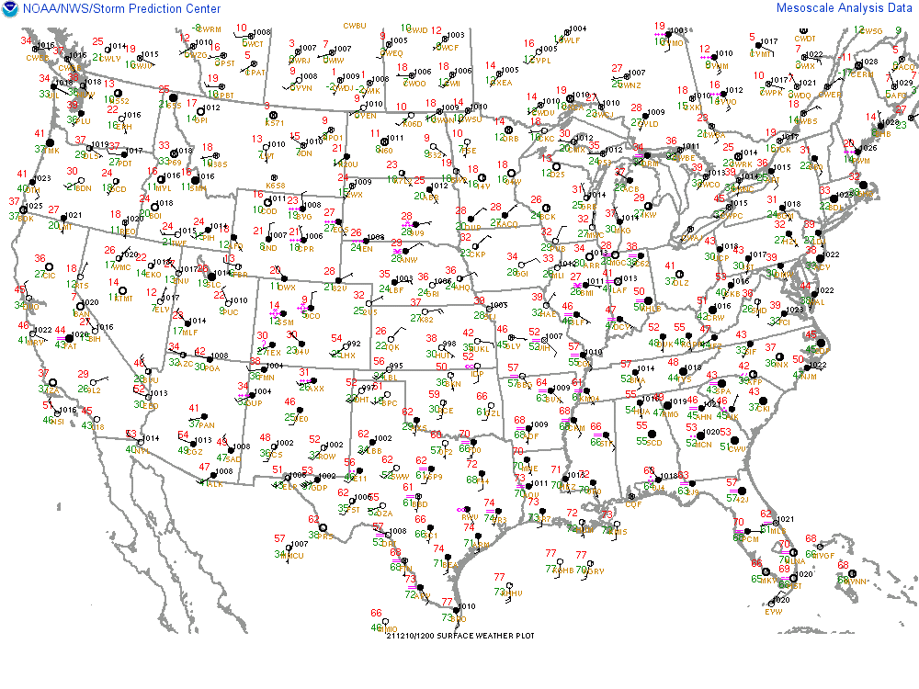
Building a Forecast Discussion
Synopsis:
Consider the surface chart to the left…
In a few sentences describe the surface pattern, including notable features such as fronts, drylines, etc….
Example:
“12 UTC surface observations reveals a surface low over southwest KS with a warm front extending eastward into the OH River Valley. To the south of this front, mid-60s dewpoints are spreading north.”

Slide 44
Building a Forecast Discussion
Synopsis so far:
“12 UTC 500 mb analysis shows a broad upper trough over the Four Corners region with strong south westerly flow over the central CONUS. Surface observations reveals a surface low over southwest KS with a warm front extending eastward into the OH River Valley. To the south of this front, mid-60s dewpoints are spreading north.”

Slide 45
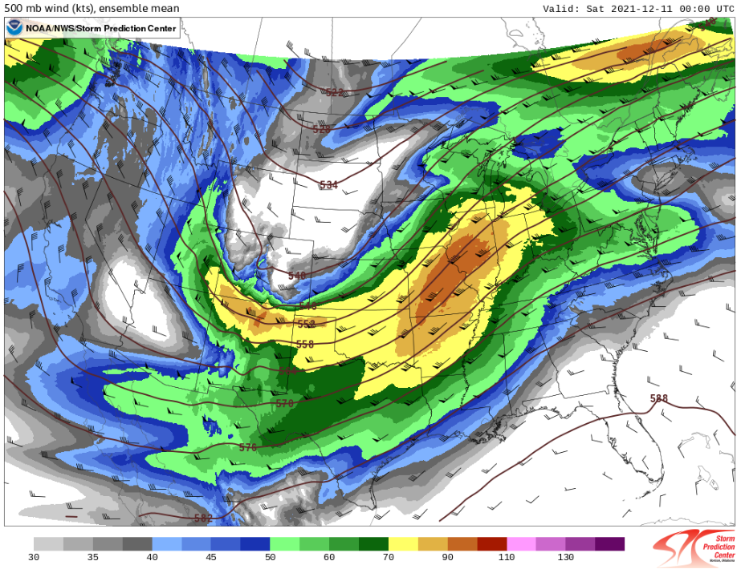
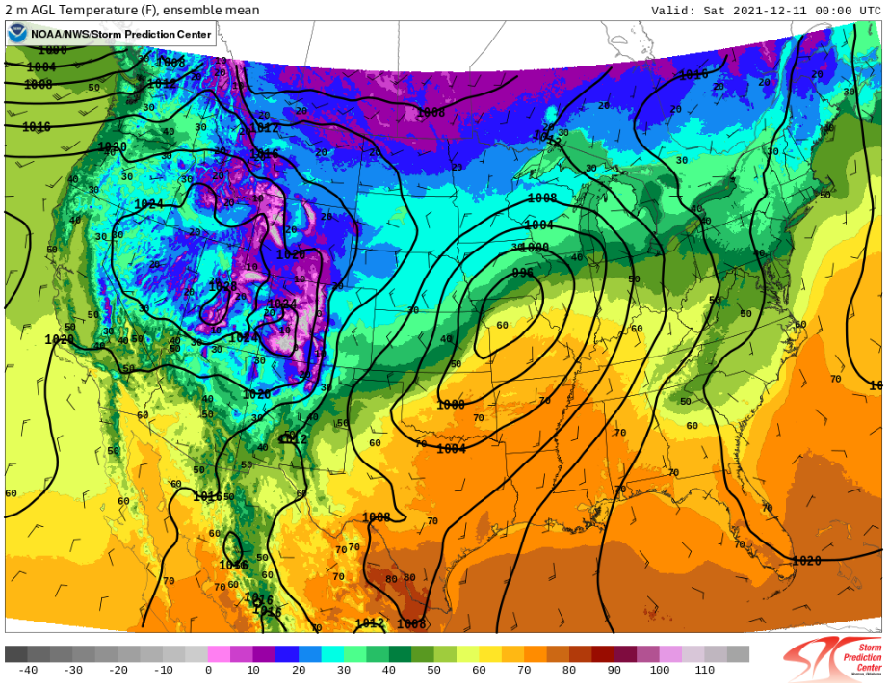
Building a Forecast Discussion
Forecast Information:
Consider the two forecast plots on the left…
In a few sentences, describe the evolution of the primary synoptic features through the day.
500 mb forecast valid 00 UTC
Example:
“The upper trough is expected to translate east through this evening. As this occurs a surface cyclone will continue to intensify and shift east along the warm frontal zone.”
Surface temperature forecast
valid 00 UTC

Slide 46
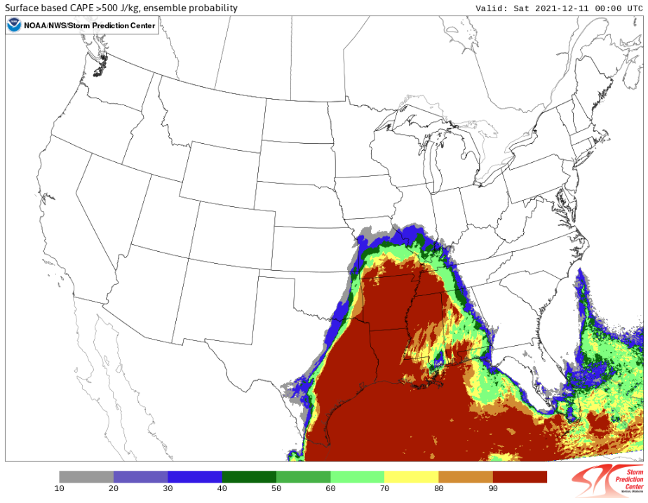
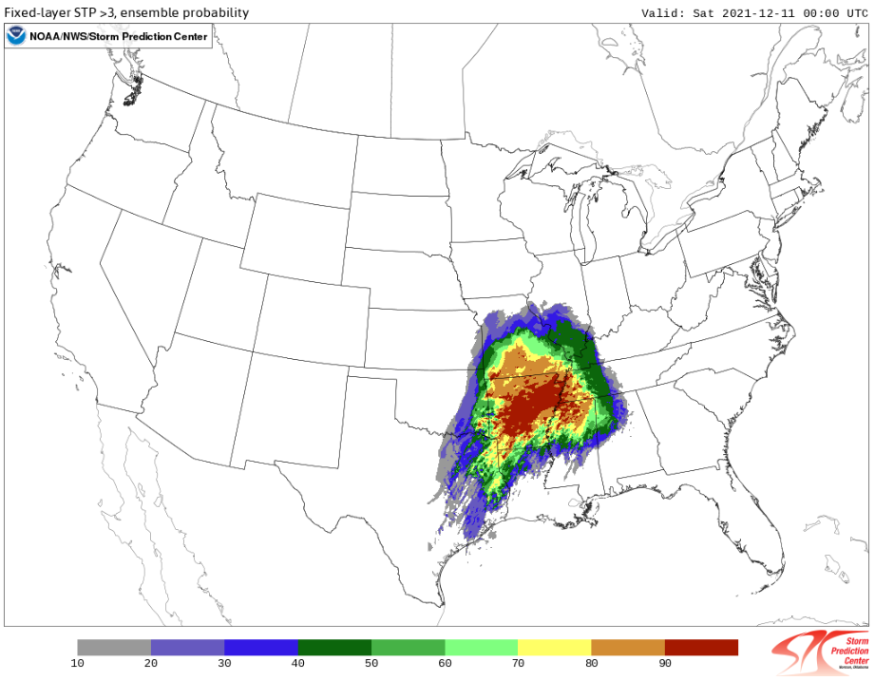
Building a Forecast Discussion
Forecast Information:
Consider the two forecast plots on the left…
In a few sentences, describe the potential for a convective environment favorable for severe weather.
Probability of SBCAPE > 1000 J/kg at 00 UTC
Example:
“Ensemble guidance shows very high (90%) probability for SBCAPE exceeding 1000 J/kg. Additionally, favorable wind profiles will support a corridor favorable for tornadoes across parts of Arkansas where there is high confidence (80% chance) in STP values above 3.”
Probability of
STP > 3
at 00 UTC

Slide 47
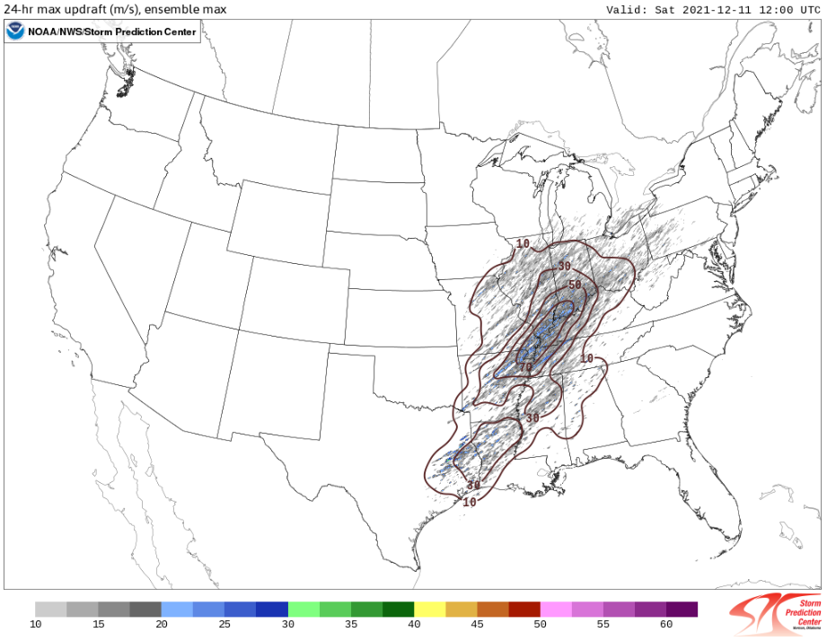
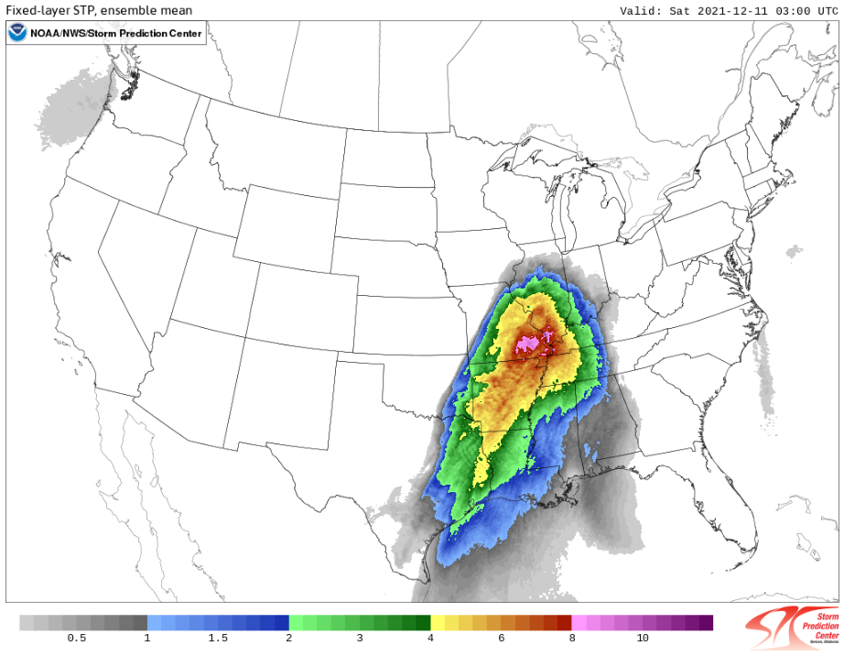
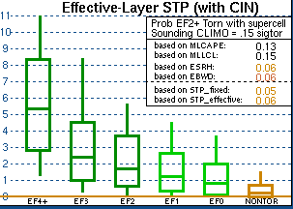
Building a Forecast Discussion
Forecast Information:
Consider the two forecast plots on the left…
In a few sentences, describe the potential for long-lived, intense thunderstorms.
24-hour max
updraft speed (fill)
Probability of updraft speed > 20 m/s (contour)
Example:
“Intense thunderstorms are probable based on latest ensemble guidance. HREF mean STP values of 8 suggest that the environment could support strong to violent tornadoes, and a strong (70%) signal for robust updrafts is noted in proximity to the STP maximum.”
HREF ensemble mean STP

Slide 48
Building a Forecast Discussion
Overall confidence assessment:
Consider all of the previous observations and forecast data….
Write one or two sentences regarding your confidence in high-impact thunderstorms.
24-hour max
updraft speed (fill)
Probability of updraft speed > 20 m/s (contour)
Example:
“All signs lend high confidence in the occurrence of numerous severe thunderstorms, including the possibility of high-impact hail, wind, or tornado event.”
HREF ensemble mean STP

Slide 49
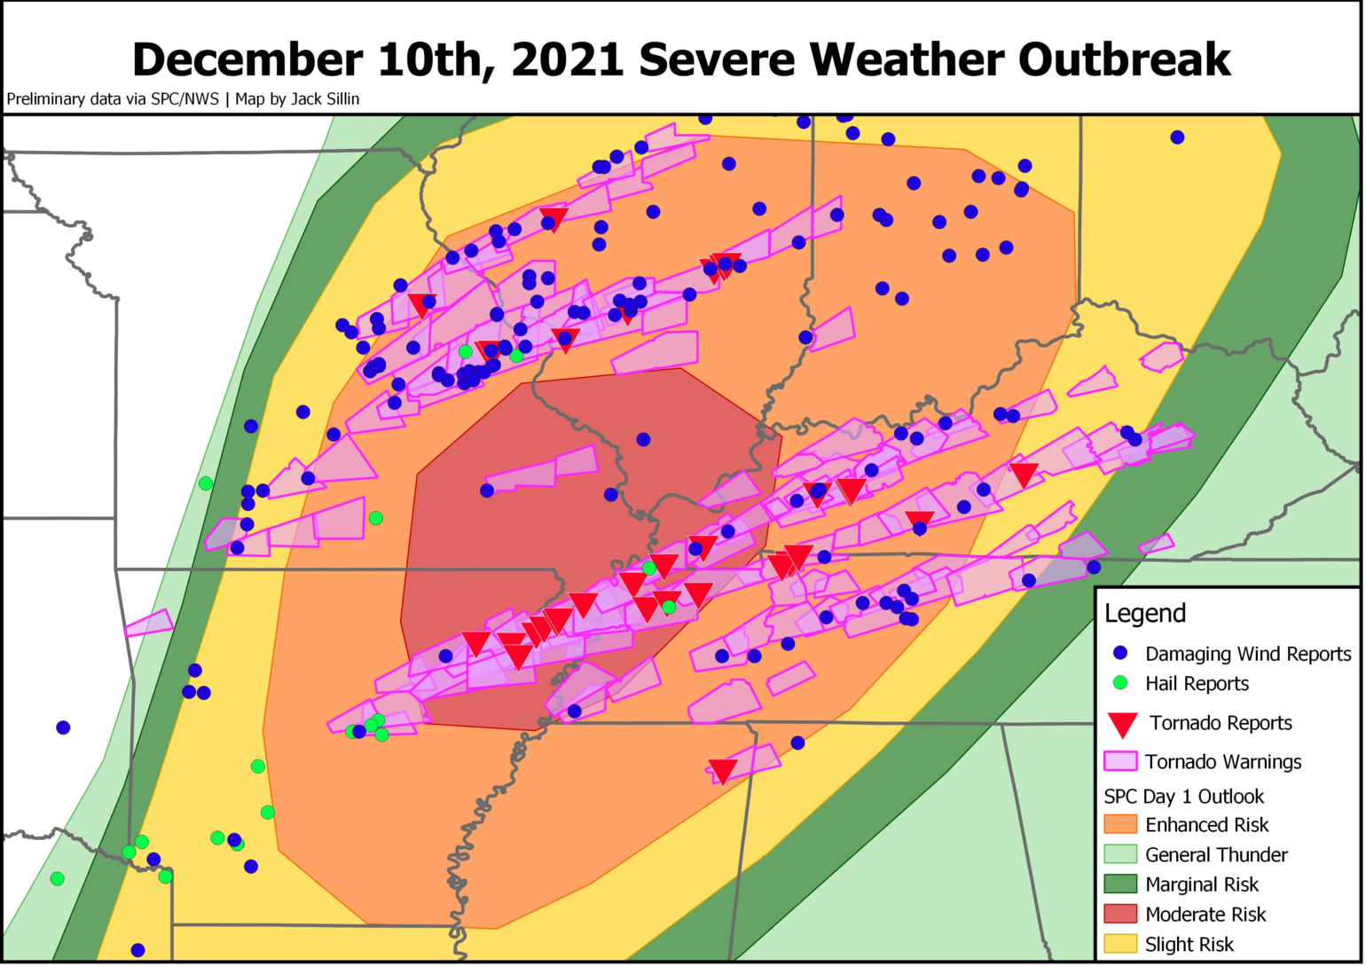
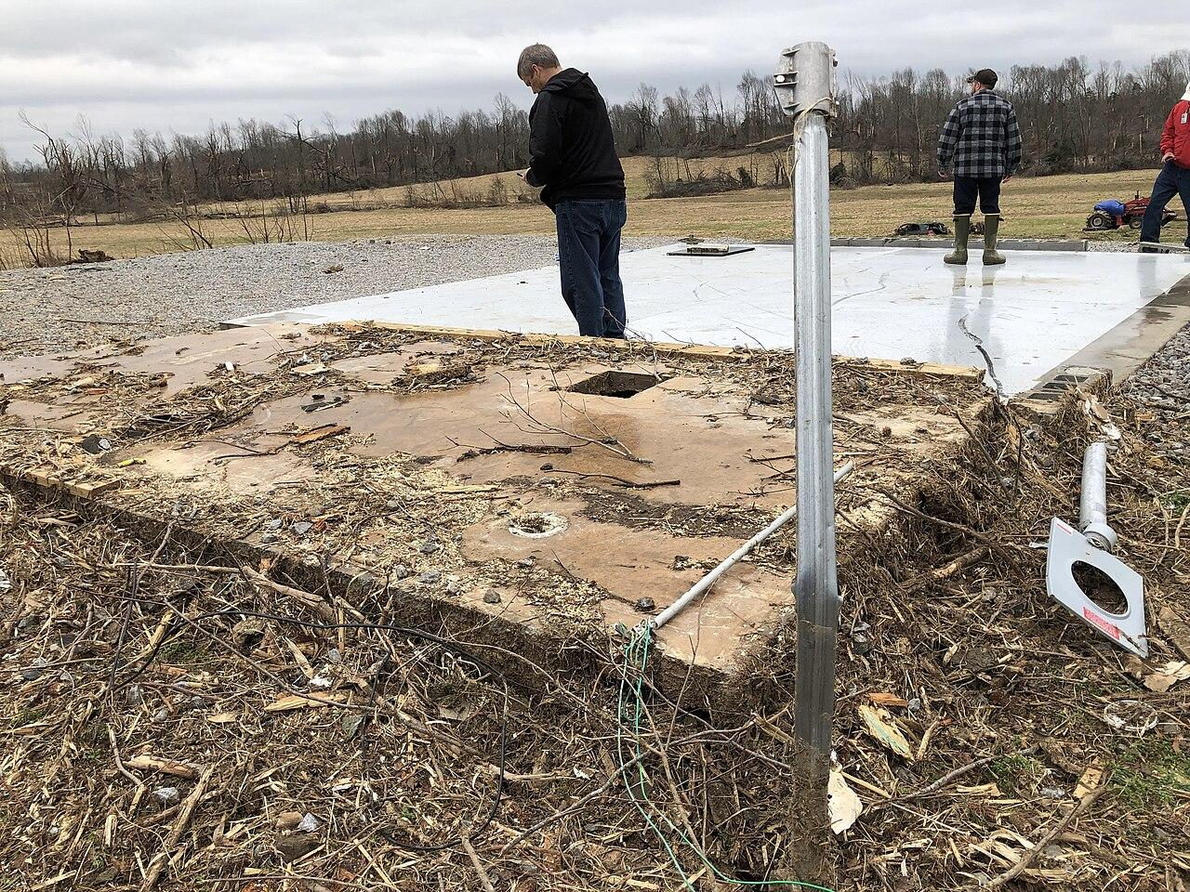
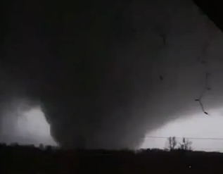
Building a Forecast Discussion
Forecast Discussion:
The upper trough is expected to translate east through this evening. As this occurs a surface cyclone will continue to intensify and shift east along the warm frontal zone.
Ensemble guidance shows very high (90%) probability for SBCAPE exceeding 1000 J/kg. Additionally, favorable wind profiles will support a corridor favorable for tornadoes across parts of Arkansas where there is high confidence (80% chance) in STP values above 3.
Intense thunderstorms are probable based on latest ensemble guidance. HREF mean STP values of 8 suggest that the environment could support strong to violent tornadoes, and a strong (70%) signal for robust updrafts is noted in proximity to the STP maximum.
All signs lend high confidence in the occurrence of numerous severe thunderstorms, including the possibility of high-impact hail, wind, or tornado event.

Slide 50
Building a Forecast Discussion
Important Takeaways:
Described the overall forecast evolution starting from observations.
Assessed the likelihood that the environment would support severe thunderstorms.
Described the probability that a favorable tornado environment would emerge.
Highlighted the potential for a high-impact event based on the probability that a high-end environment would be in place and that storms would occur in this environment.
Did not give a deterministic “this will happen”, but described confidence level in the potential for a high-impact event.
Note: This still left the door open for a “bust” event!

Slide 51
A Few Pointers
Avoid spelling and grammar mistakes.
Poor spelling and grammar reflects poorly on your office and erodes your credibility.
Avoid using subjective descriptions.
Instead of saying “insanely high MLCAPE” say “4000-5000 J/kg MLCAPE”. Keep it scientific!
Always have someone else proofread your discussion.
Read more discussions!
The more you read, the better you’ll write!
Know your audience!
Keep these in mind!

Slide 52
One last important concept:
Know your audience
Writing for other meteorologists:
WHAT
WHERE
WHEN
WHY
CONFIDENCE
POTENTIAL IMPACTS
Writing for decision makers and/or public:
WHAT
WHERE
WHEN
WHY
CONFIDENCE
POTENTIAL IMPACTS
Gives mets the scientific information they need to craft their local message to public/partners.
Allows decision makers and the public to make informed decisions and take action. They don’t necessarily care about “why” an event is occurring.
Notes:
Think about tornado warnings: The public does not need to know why a tornado is occurring, all they need to know is that a tornado is occurring, where it is, when it will arrive at their house, etc…

Slide 53
Forecast Journals
Your task:
Use observations and short/long range models to create a series of SPC-style Day 1 convective outlooks.
Each journal will have three parts:
An SPC-style outlook graphic (categorical only, no individual hazards required)
A Day 1 forecast discussion.
Post event verification and discussion
Your forecast journal will NOT be graded on forecast accuracy, but WILL be graded on:
Meteorological concepts and consistency
Incorporation of various observation networks (no model-only forecasts)
Spelling and grammar
Please see the online rubric for further instructions and expectations.

